Slide 1
Laser Based Database :D
By Joshua Castaneda & Douglas Goss
aka
Team Joto

Slide 2
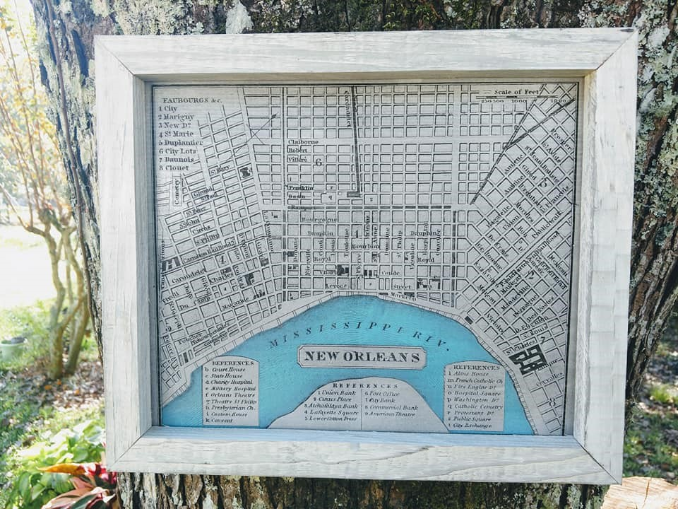
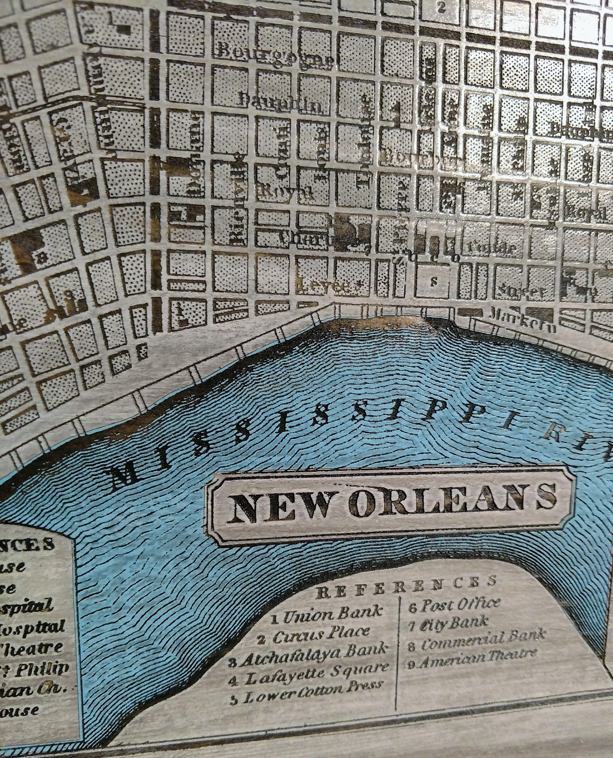
Business
The business our team will be creating a database for is a local laser-on-wood mapping workshop .

Slide 3
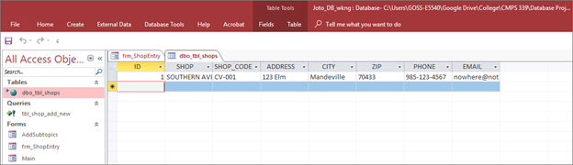
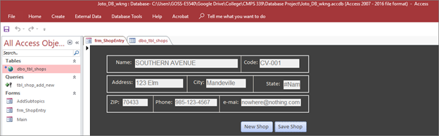
Keeping Track of Things
Being a small business, there are numerous things that a workshop owner must keep track of, whether it be employees, orders, materials, etc.
Data sources will be things such as past invoices and receipts.

Slide 4
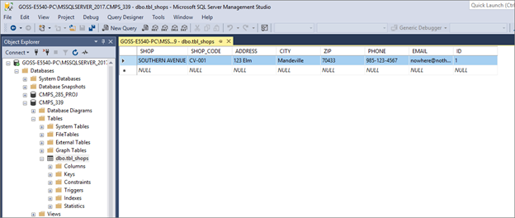
SQL Servers are great
As such, that will be the foundation of our database for its ease of use and being free.

Slide 5
Expected Timeline
Week 1 & 2 of project
Week 3 & 4 of project
Weeks 5 & 6 of project
Weeks 7 & 8 of project
1. Outlining the database needs/parameters
Thorough testing with practical use and routine
Early implementation and testing of database systems
Final errors being dealt with and overall polishing of finale product.

Slide 6
Member Roles
As of now, we plan on simply splitting the work 50/50.
Though once we get more into the specifics (more likely the specific problems) then we’ll delegate between ourselves accordingly.
But as for now...
50/50 sounds pretty fair.

